Slide 1

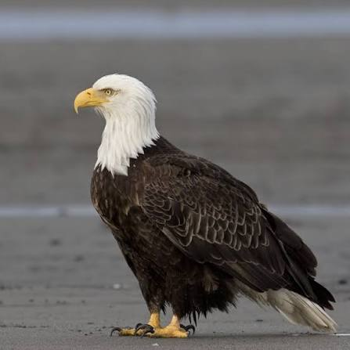
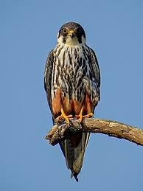
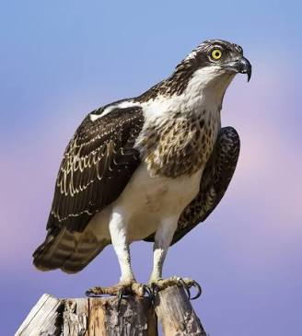
Welcome to Year 6
Eagles Falcons Osprey
Mr Davies Mrs Simpson-Wright Miss Ramsey
Our wonderful support staff: Mrs Munns, Mrs Yalamanchi, Mrs Lawrence, Ms Clohessy

Slide 2
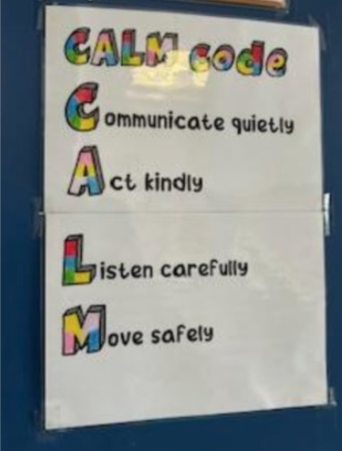

School Vision & Behaviour Expectations
School Vision: ‘ Let all that you do be done in love.’
Fruits of the Spirit: Love, Joy, Peace, Patience, Kindness, Goodness, Faithfulness, Self-Control.
Reprimand in private; praise in public

Slide 3
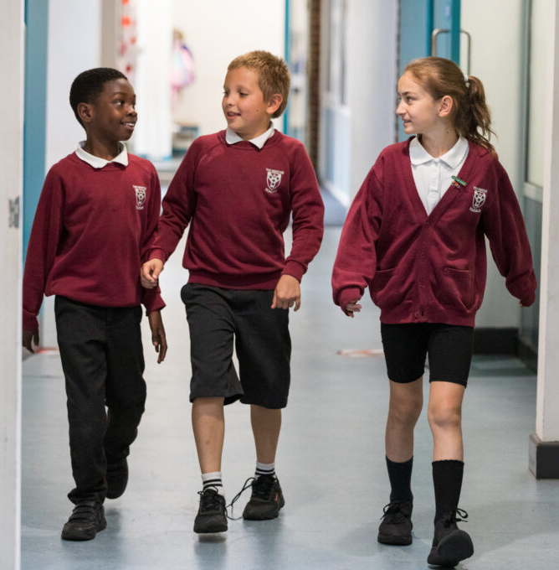
School Uniform and P.E kit
The website lays out the uniform expectations. We expect all children to be smartly presented. Please make sure all school uniform is labelled. Jewellery should not be worn, unless for religious reasons. Children can wear stud earrings which need to be removed for P.E lessons. All nails should be cut short and with no nail varnish.
We have a strict PE kit policy.
The children are expected to wear:
a plain white t-shirt
plain navy or black shorts/tracksuit bottoms
trainers
Children will be expected to come into school wearing their PE kit on PE days.
Ospreys: Monday
Eagles: Friday
Falcons: Friday

Slide 4

Attendance Matters
We aim for students to achieve at least 96% attendance for a full school year.
If pupils are absent from school, they will miss key learning opportunities resulting in gaps in their knowledge and understanding. This can significantly impact upon their learning and development.
Absence from school should only occur when a child is unfit to learn, where there is an exceptional circumstance or when the child has a day of religious observance.
If you have exceptional circumstances and wish to request a leave of absence during term time, you can complete the request form (available from the office and school website) and return it to the school office as far in advance of the requested leave period as possible.

Slide 5







English
Our Curriculum
Maths
In English we focus on a range of different texts, for teaching both reading and writing skills. The children produce a variety of writing reflecting different genres.
We place enormous value on reading as it is foundational for all subjects.
Children must read daily to understand vocabulary along with the purpose of writing. Some books that we are looking at in Year 6 are:
We follow the White Rose scheme and the Teaching for Mastery approach .
The topics we cover:
Place value up to 10 million
Roman numerals
Negative numbers
Four operations +, -, x, /
Fractions, Decimals and Percentages
Measures: length, mass, capacity, area, volume
Shapes: 2-D and 3-D
Statistics
Position and Direction: co-ordinates
Converting units of measurement

Slide 6



As a Church of England school, we have our Religious Education learning at the core of our school life.
In Year 6, the first topic that we learn about is How the Christian message has survived over the years which is centred around Christian teachings.
In R.E., over the year,
we cover the religions of
Christianity, Judaism and
Faith in the local community.
Children of all faith are included and celebrated in our RE lessons.

Slide 7

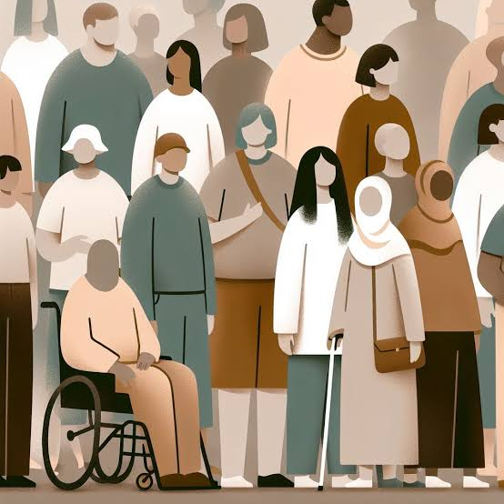
Curriculum
We follow the Kapow Primary curriculum focusing on: Geography, History, Music, Art and DT.
This half term’s topic in History is
Census and Migrations
For English, we will be focusing on books based on this theme.

Slide 8
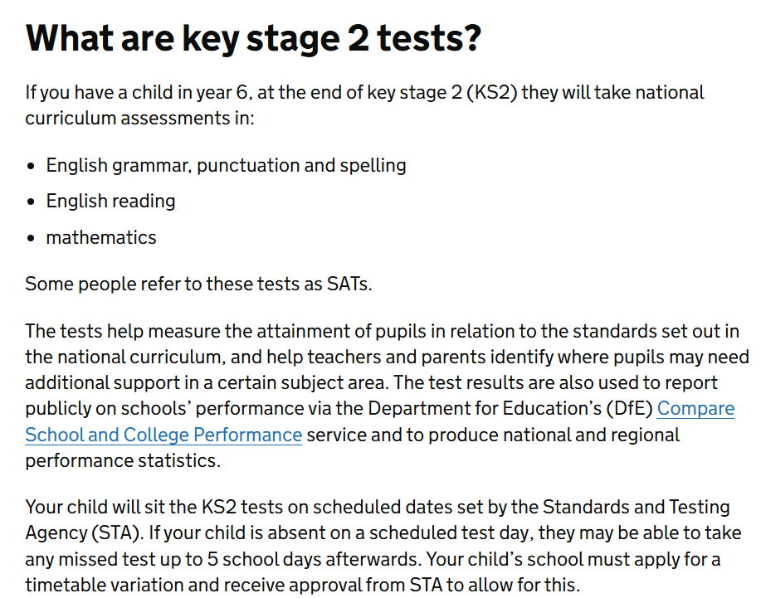
Information about SATs at the end of Year 6
(week of the 10th May 2027):

Slide 9
Year 6 Boosters
Boosters will be provided for the children that need extra support to consolidate their learning.
Boosters will start in October 2026.
Children will be given letters inviting them to the booster session towards the end of September.
Booster sessions will run from 3:15pm to 4:00pm on Mondays and Thursdays.
The 8:30am – 9:00am slot in our timetable is ear-marked for consolidating learning and every child is expected to be in class by 8:30am.
Thank you, parents, for your support in helping us prepare your children for their end of year exams as well as their secondary education.

Slide 10

Home learning
Home learning will be go out on Tuesdays
They should be brought back to school, completed, the following Monday
The home learning tasks will consist of:
  a Maths worksheet,
  a reading comprehension
  spellings words
  They will also be expected to go on TTR (Times Table Rockstar)
They are expected to be reading everyday at home for pleasure for at least 30 minutes per day.
If the homework is not returned on Monday they are expected to stay back on Tuesday lunch times to complete it (unless there are extenuating circumstances and a letter is provided by the parents/carers to the class teacher).

Slide 11

Application to secondary schools
Applications are open now
The last date for applying is the 31st of October. Anything after that is considered a late application and will not be considered till all the applications are processed. This means that your child will be unlikely to receive a place at one of your preferred schools.
If you need any help in this process, please contact the school office/ Mrs Robertson, who is our family link worker.
Please start going onto the Croydon Council website to find a secondary school best suited for your child.

Slide 12
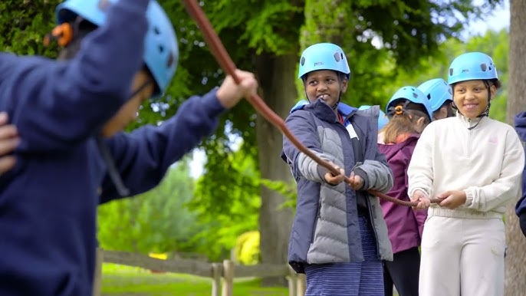
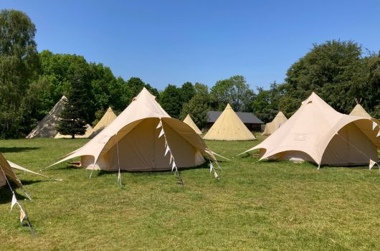
Year 6 Residential
Year 6 will be going on their residential to High Ashurst (dorm rooms).
We will be going from 5th July to 7th July.
More information about the payment will be sent out nearer to the time.
https://www.surreyoutdoorlearning.uk/centres/high-ashurst

Slide 13




Slide 14
Thank you for attending this information afternoon.
If you have any further questions then please don’t hesitate to ask any member of the Year 6 team.

