Slide 1
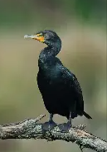
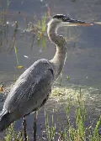
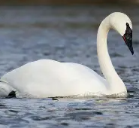
Welcome to Year 5
Cormorants
Miss Hewitt
Herons
Mrs Bhasin
Swans
Miss Baillie-Young
Our fabulous support staff: Mrs Munns, Ms Small and Mrs Bryan

Slide 2
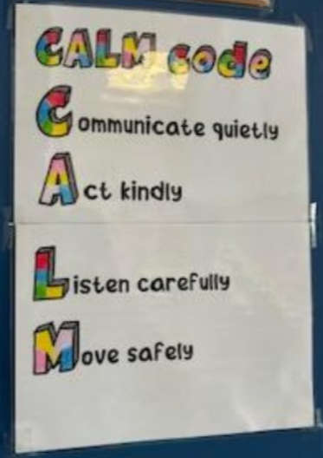
School Vision, Values & Behaviour Expectation
School Vision: ‘Let all that you do be done in love.’
Fruits of the Spirit: Love, Joy, Peace, Patience, Kindness, Goodness, Faithfulness, Self-Control.
Team points are given out as rewards.

Slide 3
Timetable
Gates open and classroom doors open at 8:25 am
Gates close at 8:40 am
Registration closes at 8:40 am
Whole school Collective Worship at 9:00 am-9:20 am
Learning Time 9:20am – 10:45 am
Break 10:45 am – 11.00 am
Learning Time 11 am - 12:30 pm
Lunch 12:30 pm – 1:25 pm
Learning Time 1:25 pm – 3:10 pm
Home Time 3:10pm

Slide 4
School Uniform
School Uniform
PE Kits (Wednesday)
School jumper or cardigan, grey skirts or grey trousers/shorts, and a white polo shirt.
In the summer, girls may wear a dark red check dress.
Shoes must be sturdy black flat school shoes – no trainers please .
Socks and tights can be grey or black.
No jewellery (unless religious)
All children should have a plain white T-shirt, plain black shorts and a pair of trainers.
Warm black or grey track suit bottoms and the school jumper should be worn for outdoor games in the colder months.
Please mark your child’s uniform with their name to avoid it being lost.

Slide 5


English
Our Curriculum
Maths
In English we focus on a range of different texts, for teaching both reading and writing skills. The children produce a variety of writing reflecting different genres. We place enormous value on reading as it is foundational for all subjects.
Children must read daily to understand vocabulary along with the purpose of writing. Some books that we are looking at in Year 5 are:
Beowulf
Hidden Figures
The Good Thieves
Black and British
Odyssey
The story of the Titanic
We follow the White Rose scheme and the Teaching for Mastery approach .
The topics we cover:
Place value up to 1 million
Roman numerals
Negative numbers
Four operations +, -, x, /
Fractions, Decimals and Percentages
Measures: length, mass, capacity, area, volume
Shapes: 2-D and 3-D
Statistics
Position and Direction: co-ordinates
Converting units of measurement

Slide 6

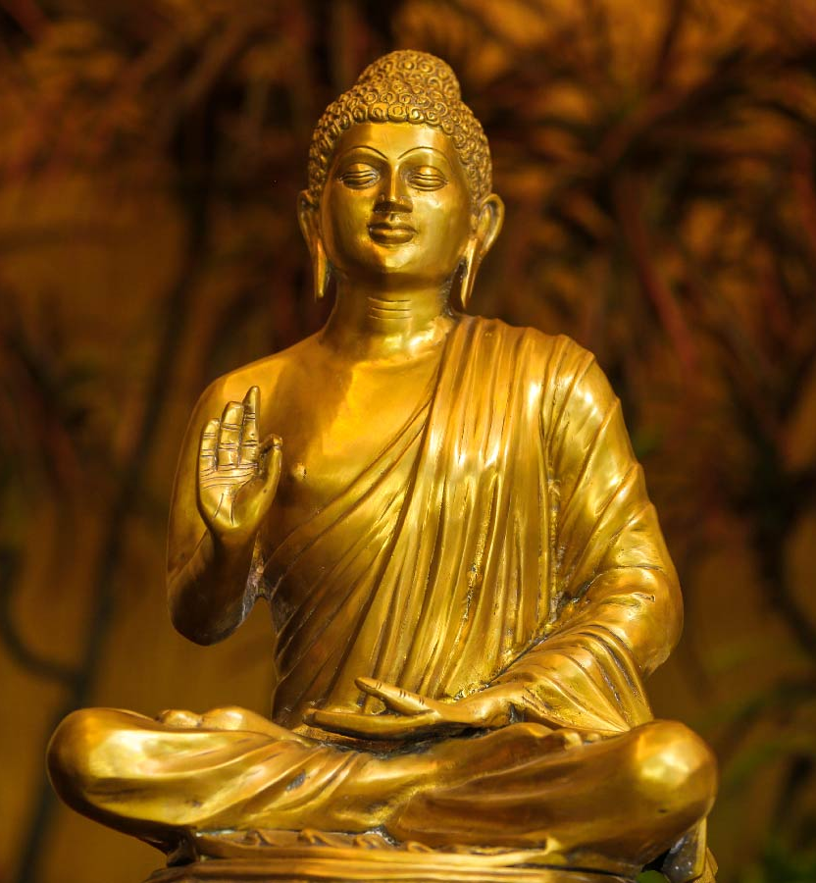
Religious Education
Throughout the years, the children will learn about Christianity along with all the other major religions.
Autumn 1: Christianity
Autumn 2: Christianity
Spring 1: Buddhism
Spring 2: Christianity
Summer 1: Buddhism
Summer 2:Christianity

Slide 7
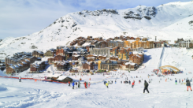
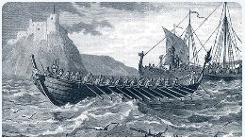
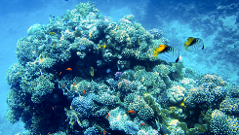
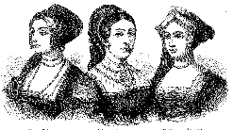
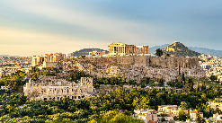
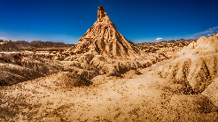
Humanities (Geography & History)
We follow the Kapow curriculum focusing on Geography and History.
Each half term we learn about a new topic.
Autumn : What is life like in the Alps?
: Were the Vikings raiders, traders or something else?
Spring : Why do oceans matter?
: What was life like in Tudor England?
Summer : Would you like to live in a desert?
: What is the legacy of the ancient Greek civilisation?

Slide 8
Science in Year 5
We follow the Kapow curriculum in Science:
Materials: Mixtures and separation
Materials: Properties and changes
Forces and space: Earth and space
Living things: Life cycles and reproduction
Forces and space: Unbalanced forces
Animals: Human timeline

Slide 9
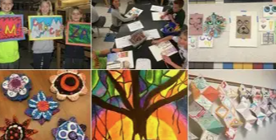
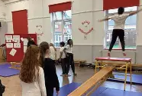

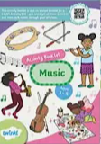

Our broader curriculum offer:
Art
Music
PE
PSHE
Spanish

Slide 10
Home Learning:
Home learning tasks go out on Tuesdays
They should be brought back to school, completed, the following Monday
The home learning tasks will consist of:
- a Maths worksheet practising the skills they are learning that week
- a reading comprehension
- spelling words
A topic-based project for each half-term
Daily reading – for at least 30 minutes per day. This would be recorded in a reading record (we are awaiting the order)
Times Tables Rockstar – online maths platform (log-ins to go out shortly)

