Slide 1
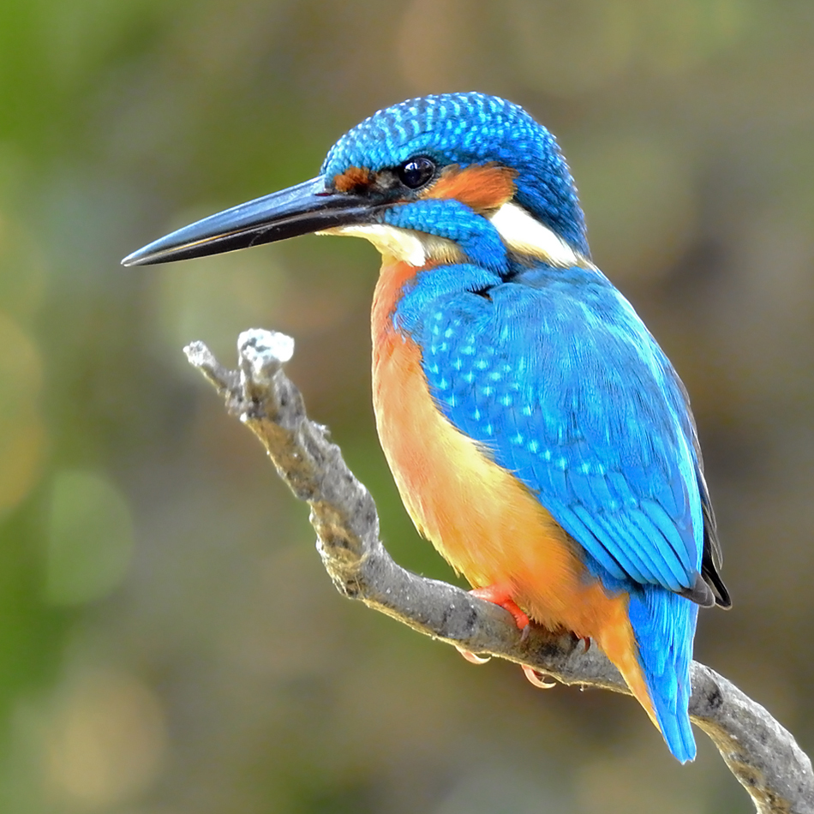
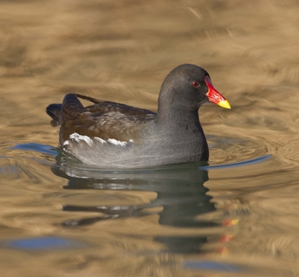
Welcome to Year 3
Kingfishers
Mrs Shirley
Mrs Williams
Moorhens
Miss Ali
Mrs Lim
Mrs Kochi

Slide 2

School Vision and Values
School Vision: ‘Let all that we do, be done in love”
Fruits of the Spirit: Love, Joy, Peace, Patience, Kindness, Goodness, Faithfulness, Self-Control.
In Friday’s Worship, children are commended for living by the Fruits of the Spirit. We also celebrate their achievements with Star of the Week.

Slide 3
Timetable
TF
Gates open and classroom doors open at 8:25am
Gates close at 8:40am
Registration closes at 8:45am
Whole school Collective Worship at 9:00am-9:15am
Learning Time 9:30am – 10:30am
Break 10:45am – 11.00am
Learning Time 11am - 12:30pm
Lunch 12:30pm – 1:25pm
Learning Time 1:25pm – 3:10pm
Home Time 3:10pm (collect the children at the door)

Slide 4



English
LR
Maths
We follow the White Rose scheme and Oak Academy.
In English we focus on a range of different texts and the children produce a variety of different pieces of writing.
The topics we will be covering:
Numbers to 1000 - Time
Addition and Subtraction - Money
Multiplication and Division - Fractions
Length, Mass and Volume - Statistics
Time

Slide 5
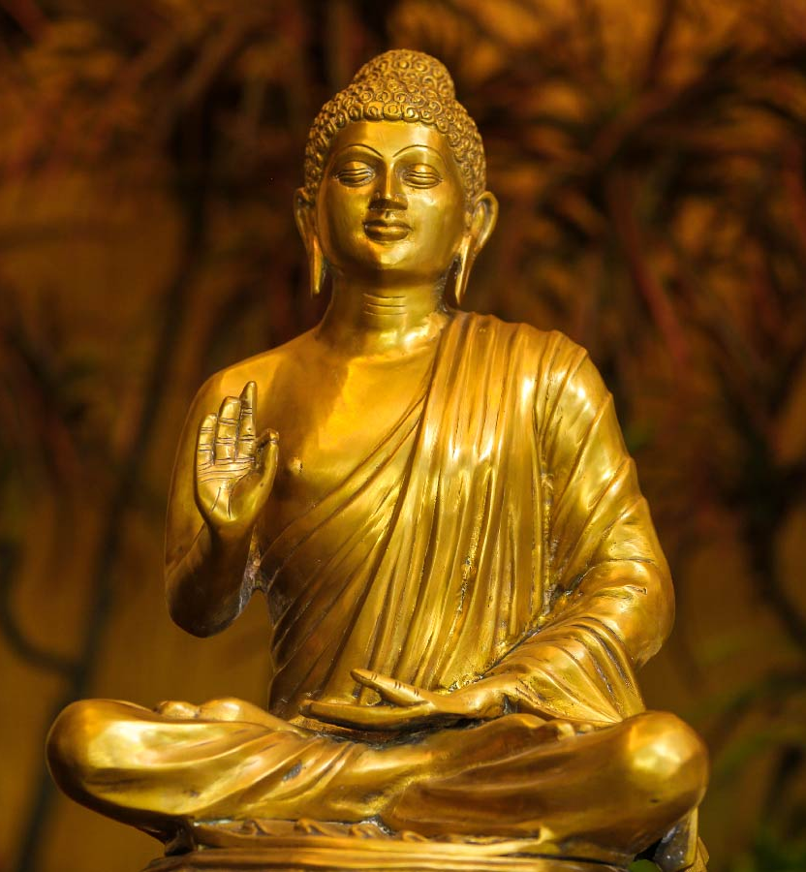

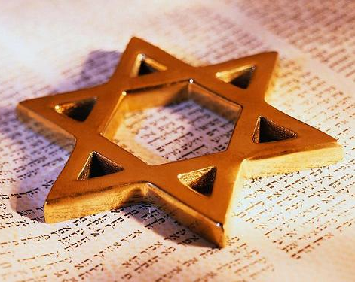
Religious Education
Throughout the years, the children will learn about Christianity along with all the other major religions.
Autumn 1: Christianity
Autumn 2: Christianity
Spring 1: Hinduism
Spring 2: Christianity
Summer 1: Christianity
Summer 2: Hinduism

Slide 6
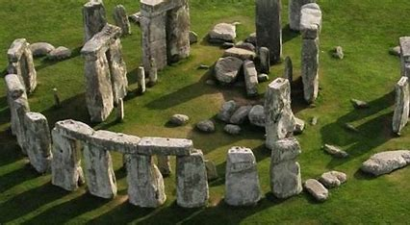
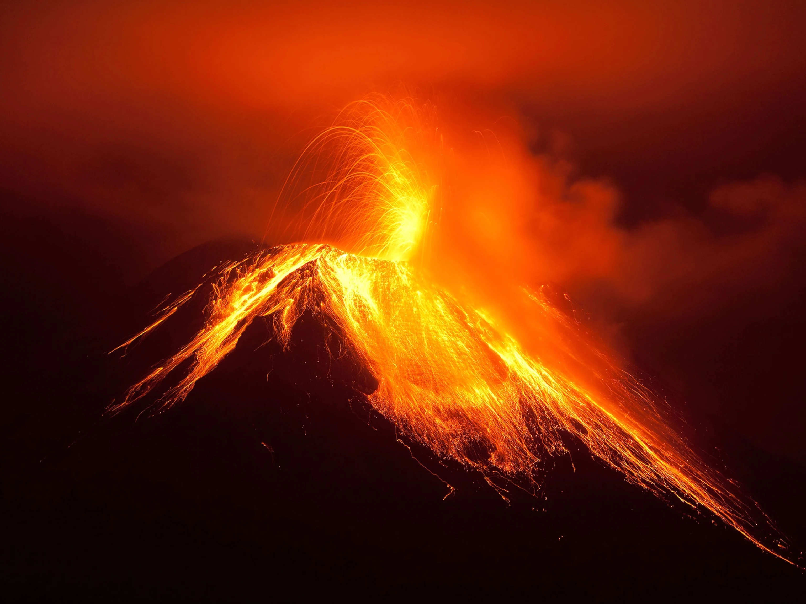
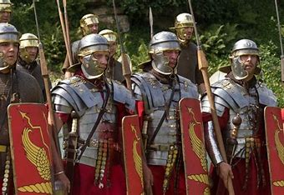
Humanities (Projects)
We follow the Kapow curriculum focusing in Geography, and History. Each half term we stat a new topic.
Autumn : Stone Age
Spring : British History
Summer: Eygptians
The children will receive termly topic related projects for home learning.

Slide 7
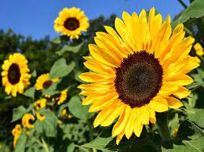
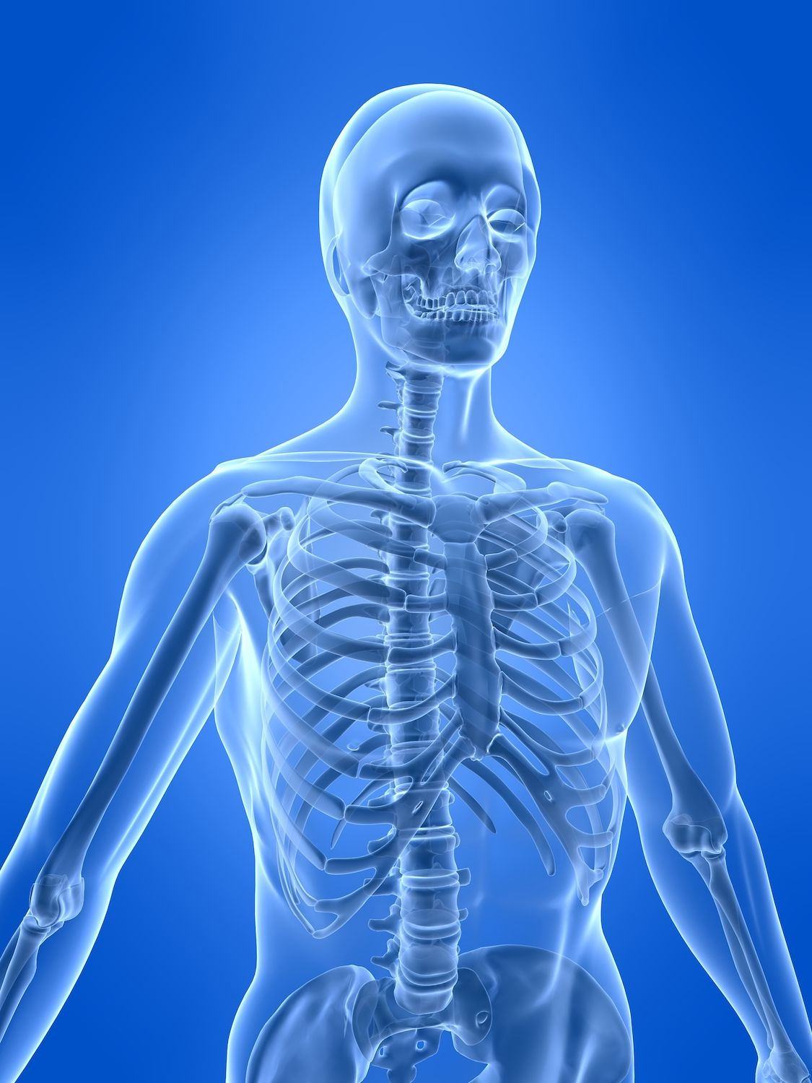
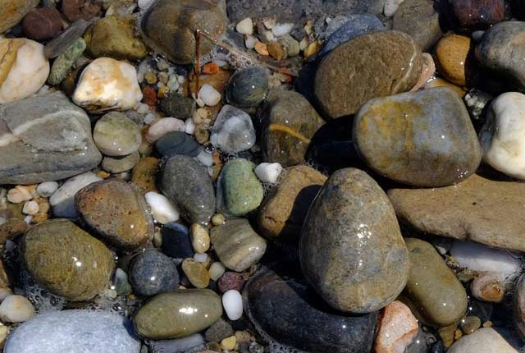


Science in Year 3
Autumn 1: Animals
Autumn 2: Forces and Space
Spring 1: Materials: Rocks and Soils
Spring 2: Energy: Light and Shadows
Summer 1: Making Connections
Summer 2: Plants

Slide 8
Wider Offering
Children have Art lessons, Spanish, PSHE and Music. Thereare Workshops on a Monday that also provide children with varies opportunities.

Slide 9
Home Learning
Children receive weekly homework on a Tuesday, which comprises of Spellings, Maths, daily reading and termly Topic projects.
The home learning must be returned every Mond
Reading is very important. Research shows that the most successful children at school read regularly. We recommend 10 minutes reading to an adult per day.
The school have provided reading records, parents should sign it to confirm that they have read with their child.

Slide 10
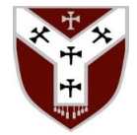
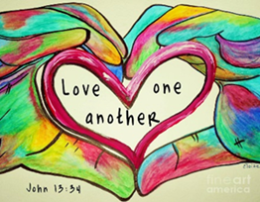
Respect, Responsibility, Peace, Love, Cooperation, Honesty, Faith, Humility, Hope, Trust, Care & Stewardship.
CALM Code
C
A
L
M
Communicate calmly and politely
Act kindly
Listen carefully
Move slowly and safely inside the school
'Let us be concerned for one another, to help one another to show love and do good'. Hebrews 10:24
Notes:
Greeting

Slide 11
School Uniform
School Uniform
PE Kits (Tuesday)
School sweatshirt or cardigan, grey skirts or grey trousers/shorts, and a white polo shirt.
In the summer, children may wear a dark red check dress.
Shoes must be sturdy black flat school shoes – no trainers allowed.
Socks and tights can be grey or black.
All children should have a plain white T-shirt, plain black shorts and a pair of trainers.
Warm black or grey track suit bottoms and a fleece top can be worn for outdoor games in the colder months.
Please mark your child’s uniform as we get a lot of lost uniform.

